Slide 1
HCP Channel Preference
Summary of Pulse, ATU, & Navigator Findings

Slide 2
Objectives of Findings
Results of the various findings are intended for reflection, to be used as valuable context when selecting primary channels in HCP Journeys, rather than dictating which channels are essential.
Note that findings from the ATU & Navigator reports do not always align, and thus consideration must be taken when using results

Slide 3

Veeva Pulse Field Engagement Global Trends
Veeva Pulse data shows us increased use of digital channels in the past year, accelerated due to COVID-19
+614%
36%
Emails Sent
Avg. Open Rate
-73%
+670%*
19min.
Events
Engage Meetings
Avg. Meeting Duration
January 2020 - March 2021
*Engage Meetings March 2020 – March 2021 comparison

Slide 4
ATU Insight Reports Summary
Current frequency of interactions
Pharma rep emails & emails/newsletters from pharma companies are the most common, followed by F2F meetings with reps
Channel effect on 1st Line Preference
Impact of Services: Activities such as patient support services have a higher impact on first line preference than “channel”
Human Contact: Rep/MSL direct contact with HCP have a high impact on preference. There is not a notable difference between F2F v Remote
One-to-Many: Impact of channels decreases with “one-to-many” channels, such as webinars, CME, eDetialing via pharma website, compared to the impact of Human contact
Interaction Findings
MSL v Rep Interactions: MSLs requires less channels than Rep interactions to achieve the same preference score
Impact of Services: Impact of services increases when multiple services are offered (e.g. patient support & medical information
“Light” Interactions: Channels like company websites, emails, and direct mail tend to underperform all other channels

Slide 5
Navigator Data - Regional Summary
Background: Channels were grouped into the four following categories: Owned- Promo “Commercial”, Owned – Medical, Paid, and Earned
There are both consistencies & inconsistencies across markets to note in designing the regional HCP Journeys
Order of Impact
Earned
Paid
Owned-Medical
Owned-Commercial
 | Owned - Commercial | Owned – Medical | Paid | Earned
Regional Winners | F2F Reps: Viewed as high reach for this category across markets Pharma Website/ Emails/ eNewsletters: perceived generally as high reach/low impact | Pharma Webcasts: Very high reach scores (mid-impact) across multiple markets Scientific Meetings Medical Education | eCME: consistently scored high on impact & reach Scientific Websites/ Newsletters/ Search Engines (i.e. 3rd party) | Medical Journals International or National Congresses
Key Findings | Perceived Value of Sample Service differs significantly across markets. Responses show this category to be primarily useful for reach | MSL F2F scores flux across markets Patient support services scores flux across markets | Banner, TV ads, and Journal ads generally score very low on both metrics | KOLs score generally highly on impact and very low on reach Treatment Guidelines: Although high across markets, scores in IT & ES significantly higher than the other channels

Slide 6
Prior Session – Channel Brainstorming
Paid
Owned
Virtual 3rd party Events /
Congresses
E-Detail (F2F)
Remote Engage Call
High Priority
VAE
3rd Party Portals
Webinar
(virtual peer-to-peer)
Websites
Self eDetail
Funtionality not yet active
Digital Media Campaign
Leave Behind
Low Priority
Podcast
Physical Mail
Mass Email
3rd Party Publication
Social Media
Campaigns
Tbd what this actually refers to

Slide 7
Navigator Summaries

Slide 8

Summary of Navigator Findings - Belgium
Overall Findings:
In Belgium, Earned Channels are the most successful in terms of both reach and impact.
F2F from both reps & MSLs result in the highest reach.
Scoring of channels is more varied than for other markets.
Most paid & owned channels sit in the mid-range of reach & impact, and thus channel usage should rely on the detail below.
Detailed Summary
 | Owned - Commercial | Owned – Medical | Paid | Earned
Top Performing Channels | F2F Rep – highest Reach and comparable impact to leaders in this group Sample: results in high reach and high impact Edetail: Very High impact, very low reach | Scientific Meetings: High Reach & High Impact F2F MSL – Highest reach in this group, mid impact Phase IV – mid reach high impact PSPs, Pharma support centers, pharma webcast – high impact, very low reach | Scientific Website & CME: Highest impact, mid/low reach Scientific newsletters, Search engines, ePrescribing, & Conference Booths all mid-level reach & impact LinkedIn: Very high impact, very low reach | National/International Congress, Medical Journal (print or online) & Treatment Guidelines: best in class reach & impact across channels Professional associations & peers: high impact compared to other channel types but mid reach
Key Findings | F2F Rep meetings result in #1 reach across channels (despite low/mid impact) Rep Emails/Pharma Enewsletters: result in mid reach/mid impact | Medical channels generally result in greater impact than Commercial channels | Paid channels vary significantly in both reach and impact so must be selected carefully Banners & TV ads ranked very low on both fields | Highest reach & impact channels are within this group KOLs are scored as high impact but very low reach

Slide 9
Channel | Type | Reach | Impact
Health Authority Website | Earned | 27% | 8.6
Treatment Guidelines | Earned | 64% | 8.3
Int'l Congress | Earned | 70% | 8.2
eDetail | Owned - Comm | 6% | 8.2
government | Earned | 9% | 8
Online Physician Network | Earned | 12% | 8
Colleague | Earned | 52% | 7.9
National Congress | Earned | 79% | 7.9
Hospital | Earned | 18% | 7.8
Professional Association Website | Earned | 39% | 7.8
scientific website | Paid | 39% | 7.8
KOL | Earned | 15% | 7.6
Prof Association | Earned | 21% | 7.6
CME | Paid | 48% | 7.6
Medical journal | Earned | 76% | 7.5
Online Medical Journal | Earned | 61% | 7.5
Online Congress | Earned | 52% | 7.3
Pharma app | Owned - Med | 6% | 7.2
Health Insurance | Earned | 6% | 7
Pharma Service Center | Owned - Med | 9% | 7
linkedin | Paid | 3% | 7
eCME | Paid | 30% | 6.9
Int'l Scientific Meeting | Owned - Med | 61% | 6.8
Phase IV | Owned - Med | 42% | 6.7
Local Scientific Meeting | Owned - Med | 64% | 6.5
Patient Support Program | Owned - Med | 18% | 6.5
Patient | Earned | 27% | 6.4
scientific eNewsletter | Paid | 52% | 6.4
Remote MSL | Owned - Med | 9% | 6.3
eMedical education | Owned - Med | 6% | 6.2
Patient Association | Earned | 15% | 6
Pharma webcast | Owned - Med | 18% | 5.8
search engine | Paid | 67% | 5.8
sample | Owned - Comm | 61% | 5.7
Nurse | Earned | 15% | 5.6
Medical Education | Owned - Med | 21% | 5.6
MSL | Owned - Med | 73% | 5.6
Pharmacist | Earned | 30% | 5.3
pharma website | Owned - Comm | 24% | 5.2
ePrescribing | Paid | 55% | 5.1
email rep/AM | Owned - Comm | 48% | 5
pharma eNewsletter | Owned - Comm | 42% | 5
conference booth | Paid | 64% | 5
Pharma Call | Owned - Comm | 12% | 4.9
rep/AM | Owned - Comm | 82% | 4.9
Wikipedia | Earned | 9% | 4.3
email MSL | Owned - Med | 36% | 4.2
banners | Paid | 12% | 4.2
Patient Association Website | Earned | 9% | 4
TV ad | Paid | 6% | 4
Pharma DM/newsletter | Owned - Comm | 42% | 3.7
journal ad | Paid | 45% | 3.3
remote rep | Owned - Comm | 6% | 2.5
pharma twitter | Owned - Comm | 0% | 0

Slide 10

Summary of Navigator Findings - Italy
Overall Findings:
In Italy, Earned Channels are the most successful for both impact & reach
Treatment Guidelines are perceived as the most effective channel for both reach & impact
The scoring is more clustered in Italy compared to other markets, meaning that Italian survey respondents considered different channels to achieve more similar results than for other markets
 | Owned - Commercial | Owned – Medical | Paid | Earned
Top Performing Channels | F2F Rep & Rep email: high reach, mid impact eDetailing, remote rep, and pharma website: mid-impact, mid reach | Pharma Webcast: High Reach, mid impact MSL & Phase IV: high impact, mid to low reach eMedical Education, MSL email: high reach, mid-impact | eCME: highest reach of group, high impact Scientific Website, eprescribing, & CME: high impact, mid reach Search engine: High Reach, mid impact | Treatment Guidelines – Very High reach & Impact Medical Journals (online & print) – high impact & reach
Key Findings | F2F Rep channel is not as significant to reach as for other markets Pharma call/pharma newsletter very low impact Sample is low impact and reach | Nondigital medical education is viewed as very highly impactful, but to have very low reach Medical owned channels are more varied by score than other groups. | Various paid channels are clustered as similar impact/reach Banners & TV ads ranked very low on both fields | Various channels of this group (congresses, colleagues, meetings) are clustered as high impact, mid reach KOL viewed as high impact, low reach
Detailed Summary

Slide 11
Channel | Type | Reach | Impact
Treatment Guidelines | Earned | 49% | 8.5
Medical Education | Owned - Med | 7% | 8.2
pharma twitter | Owned - Comm | 5% | 8
Online Medical Journal | Earned | 19% | 7.8
Colleague | Earned | 29% | 7.7
Pharmacist | Earned | 24% | 7.7
Online Congress | Earned | 22% | 7.7
Wikipedia | Earned | 17% | 7.7
Int'l Scientific Meeting | Owned - Med | 22% | 7.7
government | Earned | 20% | 7.6
Int'l Congress | Earned | 29% | 7.5
Medical journal | Earned | 49% | 7.5
National Congress | Earned | 37% | 7.5
KOL | Earned | 12% | 7.4
Health Authority Website | Earned | 37% | 7.4
Patient Support Program | Owned - Med | 15% | 7.4
Phase IV | Owned - Med | 15% | 7.4
MSL | Owned - Med | 29% | 7.2
eCME | Paid | 61% | 7.2
scientific eNewsletter | Paid | 34% | 7.2
scientific website | Paid | 39% | 7.2
Nurse | Earned | 20% | 7.1
Health Insurance | Earned | 12% | 7
Professional Association Website | Earned | 41% | 7
pharma website | Owned - Comm | 29% | 7
CME | Paid | 32% | 7
Patient | Earned | 20% | 6.9
Pharma app | Owned - Med | 12% | 6.8
Pharma webcast | Owned - Med | 59% | 6.8
Linkedin | Paid | 29% | 6.8
search engine | Paid | 51% | 6.8
Hospital | Earned | 24% | 6.7
Patient Association Website | Earned | 7% | 6.7
eDetail | Owned - Comm | 27% | 6.7
remote rep | Owned - Comm | 32% | 6.7
ePrescribing | Paid | 34% | 6.7
Online Physician Network | Earned | 20% | 6.6
Local Scientific Meeting | Owned - Med | 17% | 6.6
email MSL | Owned - Med | 39% | 6.6
rep/AM | Owned - Comm | 41% | 6.6
Prof Association | Earned | 10% | 6.5
Pharma Service Center | Owned - Med | 7% | 6.5
sample | Owned - Comm | 15% | 6.5
email rep/AM | Owned - Comm | 39% | 6.4
eMedical education | Owned - Med | 44% | 6.3
pharma eNewsletter | Owned - Comm | 54% | 6.2
conference booth | Paid | 12% | 6.2
Remote MSL | Owned - Med | 34% | 6.1
TV ad | Paid | 7% | 6
Patient Association | Earned | 10% | 5.8
journal ad | Paid | 20% | 5.5
Pharma Call | Owned - Comm | 39% | 5.3
Pharma DM/newsletter | Owned - Comm | 20% | 4.8
banners | Paid | 10% | 4.8

Slide 12

Summary of Navigator Findings - Spain
Overall Findings:
In Spain, Earned channels scores highest for impact & reach, but scores are more varied than for other countries
Owned, Commercial, & Paid Channels are highly intermixed in a cluster of low reach, mid impact.
Treatment guidelines are perceived as very high impact & reach
Social Media (linkedin & twitter) are both given mid-to-high impact scores
Detailed Summary
 | Owned - Commercial | Owned – Medical | Paid | Earned
Top Performing Channels | Rep (F2F & Email): high reach, mid impact Sample & Pharma twitter: high impact, low reach | Pharma webcast – very high reach, mid-high impact MSL & Scientific Meetings, and pharma app: mid/high impact, mid/low reach | eCME & Scientific Website: very high impact, very high reach Scientific eNewsletter & search engine: High Reach, mid impact | Treatment Guidelines: very high reach & impact Online med journal, health authority website, prof ass. Website: very high reach & impact Congresses: highest impact, mid reach
Key Findings | Edetailing viewed as low reach, mid impact Channels in this group in ES have more diverse scores than for other markets | Patient Support Program here ranked low on both scores Most channels in this group are clustered in the mid range for both scores | The scores for channels in this group vary and are not significantly clustered | KOLs – low reach, mid impact

Slide 13
Channel | Type | Reach | Impact
Int'l Congress | Earned | 34% | 8.6
National Congress | Earned | 32% | 8.4
Health Authority Website | Earned | 51% | 8.3
Treatment Guidelines | Earned | 71% | 8.2
Hospital | Earned | 27% | 8.1
Government | Earned | 7% | 8
Online Medical Journal | Earned | 59% | 8
Professional Association Website | Earned | 51% | 8
eCME | Paid | 61% | 8
CME | Paid | 24% | 7.9
Sample | Owned - Comm | 12% | 7.8
Online Congress | Earned | 32% | 7.7
scientific website | Paid | 51% | 7.7
Medical journal | Earned | 39% | 7.6
Patient | Earned | 17% | 7.6
Prof Association | Earned | 20% | 7.6
Colleague | Earned | 39% | 7.5
MSL | Owned - Med | 29% | 7.5
Pharma app | Owned - Med | 24% | 7.5
Int'l Scientific Meeting | Owned - Med | 24% | 7.4
Local Scientific Meeting | Owned - Med | 29% | 7.4
pharma twitter | Owned - Comm | 7% | 7.3
ePrescribing | Paid | 41% | 7.3
Patient Association Website | Earned | 22% | 7.2
Phase IV | Owned - Med | 32% | 7.2
Pharma webcast | Owned - Med | 78% | 7.2
Pharmacist | Earned | 37% | 7.1
Online Physician Network | Earned | 20% | 7.1
KOL | Earned | 10% | 7
search engine | Paid | 59% | 7
Medical Education | Owned - Med | 22% | 6.9
rep/AM | Owned - Comm | 41% | 6.9
remote rep | Owned - Comm | 29% | 6.9
Linkedin | Paid | 22% | 6.8
scientific eNewsletter | Paid | 59% | 6.8
Remote MSL | Owned - Med | 29% | 6.7
eDetail | Owned - Comm | 12% | 6.7
Patient Association | Earned | 12% | 6.6
eMedical education | Owned - Med | 39% | 6.6
Pharma Service Center | Owned - Med | 10% | 6.5
Pharma Call | Owned - Comm | 29% | 6.5
email rep/AM | Owned - Comm | 59% | 6.5
banners | Paid | 10% | 6.5
pharma website | Owned - Comm | 51% | 6.4
TV ad | Paid | 12% | 6.4
Nurse | Earned | 15% | 6.2
email MSL | Owned - Med | 39% | 6.2
Health Insurance | Earned | 7% | 6
Pharma DM/newsletter | Owned - Comm | 24% | 5.8
Patient Support Program | Owned - Med | 20% | 5.5
conference booth | Paid | 20% | 5.4
pharma eNewsletter | Owned - Comm | 44% | 5.2
journal ad | Paid | 37% | 4.9
Wikipedia | Earned | 15% | 4.8

Slide 14

Summary of Navigator Findings - Netherlands
Overall Findings:
In NL, Earned Channels are viewed as by far the most successful
Scoring is not highly clustered, care should be taken when selected specific channels for Netherlands
Treatment guidelines are perceived as the most impactful across channels
Detailed Summary
 | Owned - Commercial | Owned – Medical | Paid | Earned
Top Performing Channels | F2F Rep & Remote Rep: F2F rep is high reach/low impact, and remote rep viewed as high impact, low reach. Pharma Newsletters, pharma emails, website: very high reach, low impact. | Pharma Webcast: mid/high impact, mid reach Scientific Meetings, Phase IV, Medical Education: mid/high impact, low reach MSL: mid/high reach, mid/low impact | eCME: very high impact & very high reach Scientific Website, CME, & Scientific Newsletter: high impact, high reach | Medical Journal, Colleagues, Prof Ass. Site, & treatment guidelines: very high reach, very high impact Congresses: very high impact, high reach
Key Findings | Owned Commercial content is viewed as least impactful of the channel groups, but with some of the highest reach Sample viewed as very low on both scores | Owned med content generally viewed as impactful with a low reach | ePrescribing & linkedin score relatively low TV ads and banners very low impact and reach | Earned channels are viewed across the board as highly effective, with exception to health insurance KOLs score very high on impact & very low on reach

Slide 15
Channel | Type | Reach | Impact
Treatment Guidelines | Earned | 55% | 8.3
Hospital | Earned | 33% | 8
KOL | Earned | 3% | 8
Online Physician Network | Earned | 21% | 8
Professional Association Website | Earned | 55% | 7.9
Int'l Congress | Earned | 36% | 7.7
National Congress | Earned | 33% | 7.7
CME | Paid | 33% | 7.6
Online Medical Journal | Earned | 42% | 7.4
Medical journal | Earned | 61% | 7.3
Colleague | Earned | 67% | 7.2
Prof Association | Earned | 21% | 7.1
eCME | Paid | 61% | 7.1
scientific website | Paid | 42% | 7.1
Int'l Scientific Meeting | Owned - Med | 15% | 6.9
Medical Education | Owned - Med | 6% | 6.8
eDetail | Owned - Comm | 6% | 6.8
Health Authority Website | Earned | 21% | 6.6
Local Scientific Meeting | Owned - Med | 24% | 6.6
Patient Association Website | Earned | 6% | 6.5
Pharmacist | Earned | 48% | 6.4
Phase IV | Owned - Med | 18% | 6.4
Online Congress | Earned | 30% | 6.2
Pharma webcast | Owned - Med | 36% | 6.2
government | Earned | 9% | 6
Remote MSL | Owned - Med | 12% | 6
scientific eNewsletter | Paid | 45% | 6
Patient | Earned | 24% | 5.8
search engine | Paid | 64% | 5.8
Wikipedia | Earned | 15% | 5.6
remote rep | Owned - Comm | 21% | 5.6
Nurse | Earned | 33% | 5.5
eMedical education | Owned - Med | 6% | 5.5
Patient Association | Earned | 15% | 5.2
MSL | Owned - Med | 42% | 4.2
Health Insurance | Earned | 6% | 4
rep/AM | Owned - Comm | 48% | 4
linkedin | Paid | 12% | 4
ePrescribing | Paid | 24% | 3.9
Pharma Call | Owned - Comm | 9% | 3.7
conference booth | Paid | 9% | 3.7
Patient Support Program | Owned - Med | 15% | 3.6
email MSL | Owned - Med | 36% | 3.4
pharma eNewsletter | Owned - Comm | 48% | 2.7
email rep/AM | Owned - Comm | 64% | 2.6
pharma website | Owned - Comm | 18% | 2.4
Pharma DM/newsletter | Owned - Comm | 70% | 2.2
journal ad | Paid | 55% | 2.2
banners | Paid | 3% | 2
sample | Owned - Comm | 9% | 1.7
TV ad | Paid | 6% | 1

Slide 16

Summary of Navigator Findings - France
Based upon Navigator survey data of 40 Rheumatologists performed in Q2, 2020
Overall Findings:
In France, Earned & Paid channels both generally result in higher reach & impact relative to owned channels.
There are a cluster of channels across all groups sitting under a mid impact/mid reach area, meaning various channels could likely achieve similar results
Detailed Summary
 | Owned - Commercial | Owned – Medical | Paid | Earned
Top Performing Channels | F2F Rep – highest Reach and comparable impact to leaders in this group Pharma website: Same impact as F2F Reps, low/mid reach | Local Scientific Meeting: High impact, high reach Pharma webcast & eMedical Education: Mid impact, mid reach | eCME – high impact & relatively high reach Search Engine & Scientific Enewsletter – similar reach & impact to F2F rep. Scientific Website, eprescribing, & CME: high impact, mid reach | Medical Journal – High Reach & Impact Congresses, Colleagues, and Prof Association site high impact, mid reach
Key Findings | Edetaiing scored only as impactful as reps, but much lower reach Pharma newsletters and rep emails have high reach but low impact Sample service here is low impact low reach | Most channels in this group fall under low/mid reach, mid impact. MSL F2F are show low reach, mid impact. PSPs show the same impact as Rep F2F visits but much lower reach. | Paid channels vary significantly in both reach and impact so must be selected carefully Banners & TV ads ranked very low on both fields | Medical Journal has the highest reach & impact across all channels KOLs ranked very low on both reach & impact

Slide 17
Channel | Type | Reach | Impact
Prof Association | Earned | 10 | 8.2
Treatment Guidelines | Earned | 10 | 8
Prof Association Website | Earned | 25% | 7.9
ePrescribing | Paid | 25 | 7.8
Int'l Congress | Earned | 22 | 7.7
Online Congress | Earned | 40 | 7.6
Online Medical Journal | Earned | 45 | 7.6
Local Scientific Meeting | Owned - Med | 38 | 7.6
Colleague | Earned | 28 | 7.5
Medical Journal | Earned | 70 | 7.5
eCME | Paid | 42 | 7.5
Hospital | Earned | 18 | 7.4
CME | Paid | 12 | 7.4
Phase IV | Owned - Med | 25 | 7.2
scientific Website | Paid | 25 | 7.2
Medical Education | Owned - Med | 10 | 6.9
Government | Earned | 20 | 6.8
Health Authority Website | Earned | 25 | 6.8
MSL | Owned - Med | 18 | 6.8
Patient Support Center | Owned - Med | 8 | 6.8
Patient | Earned | 18 | 6.7
emedical Education | Owned - Med | 28 | 6.6
pharma webcast | Owned - Med | 32 | 6.6
Int'l Scientific Meeting | Owned - Med | 20 | 6.5
Scientific Newsletter | Paid | 48 | 6.2
Search engine | Paid | 52 | 6.2
Patient Support Program | Owned - Med | 18 | 6
pharma website | Owned - Comm | 30 | 6
Conference booth | Paid | 25 | 6

Slide 18
Pulse Trends by Country

Slide 19
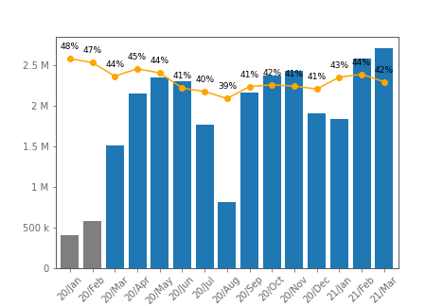
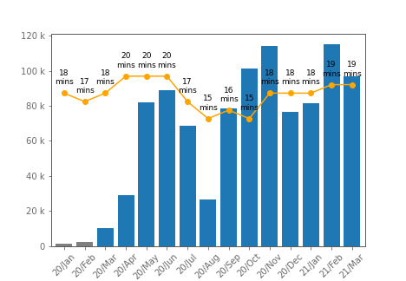




EU - Acceleration of Life Sciences Digital Engagements
+582%
Approved Emails Sent
+870%*
Engage Meetings Started
42%
Avg. Open Rate
18 min.
Avg. Meeting Duration
*Engage Meetings March 2020 – March 2021 comparison

Slide 20
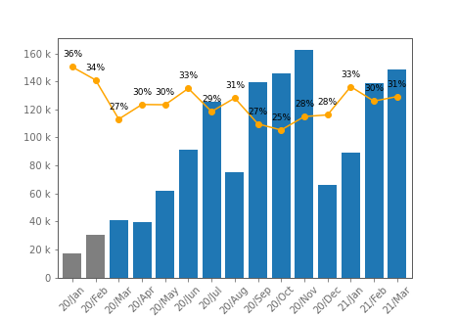
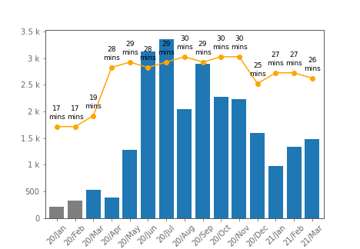
Great Britain - Acceleration of Life Sciences Digital Engagements
+781%
Approved Emails Sent
+180%*
Engage Meetings Started
29%
Avg. Open Rate
28 min.
Avg. Meeting Duration
*Engage Meetings March 2020 – March 2021 comparison

Slide 21
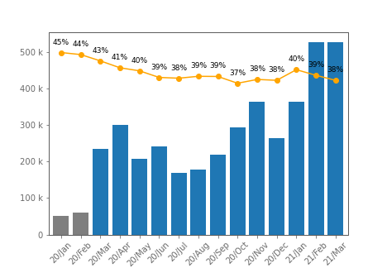
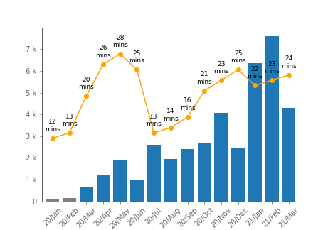
Germany - Acceleration of Life Sciences Digital Engagements
+929%
Approved Emails Sent
+557%*
Engage Meetings Started
39%
Avg. Open Rate
21 min.
Avg. Meeting Duration
*Engage Meetings March 2020 – March 2021 comparison

Slide 22
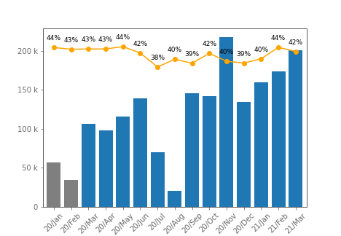
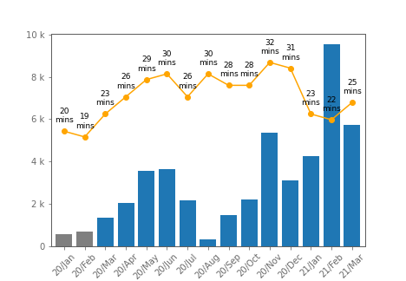
France - Acceleration of Life Sciences Digital Engagements
+252%
Approved Emails Sent
+335%*
Engage Meetings Started
41%
Avg. Open Rate
27 min.
Avg. Meeting Duration
*Engage Meetings March 2020 – March 2021 comparison

Slide 23
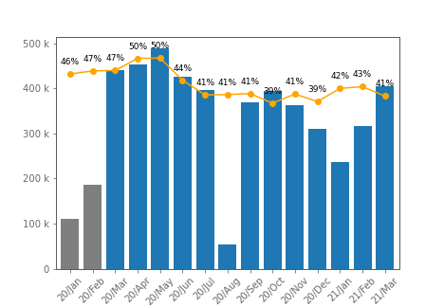
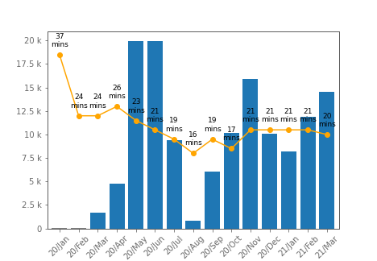
Italy - Acceleration of Life Sciences Digital Engagements
+268%
Approved Emails Sent
+750%*
Engage Meetings Started
43%
Avg. Open Rate
21 min.
Avg. Meeting Duration
*Engage Meetings March 2020 – March 2021 comparison

Slide 24
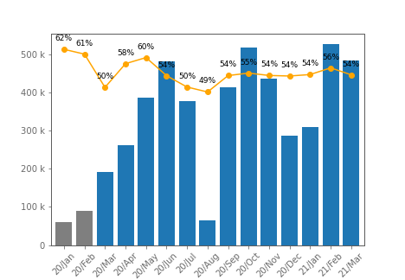
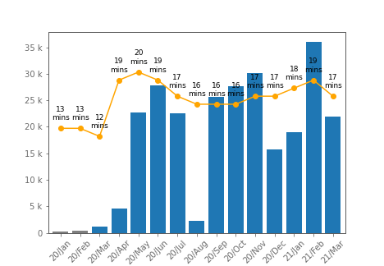
Spain - Acceleration of Life Sciences Digital Engagements
+699%
Approved Emails Sent
+1,891%*
Engage Meetings Started
54%
Avg. Open Rate
17 min.
Avg. Meeting Duration
*Engage Meetings March 2020 – March 2021 comparison

Slide 25
Patient support service
Rep- via telephone or webcam/internet
MSL– face to face
Rep - face to face
MSL– via phone, webcam or email
Webinars led by pharmaceutical manufacturers
Online educational meetings (CME) hosted by company
Medical information service
E-detail/self-detailing via company website (without a Rep)
Pharmaceutical company representatives - via email
Local meeting presenting product information
Pharmaceutical company websites
Visit to pharmaceutical company booth at conference
Emails/newsletters from pharmaceutical companies
Direct mail (via post) from the pharmaceutical company
Highest impact on 1L preference
*
Comparable impact between f2f vs. remote
Impact declines when channels become more one-to-many and less personal
Impact declines further when channels become less interactive (with the exception of booth visit, although this could be due to its virtual nature
* Having interacted with a company about PSP
Notes:
In which of the following ways have you interacted with the manufacturers of each of the following products in relation to Janus Kinase (JAK) inhibitors for the treatment of Rheumatoid Arthritis in the last 3 months.

Slide 26
Appendix – Channel Story

Slide 27
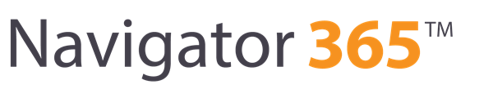

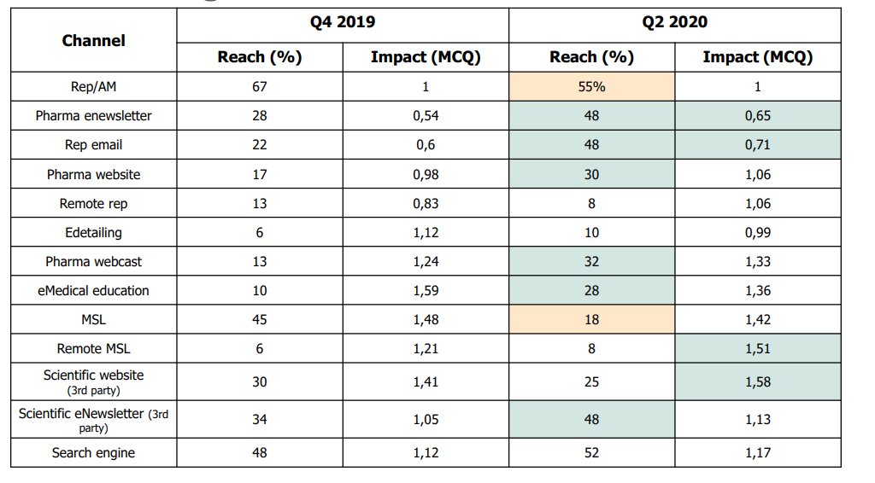
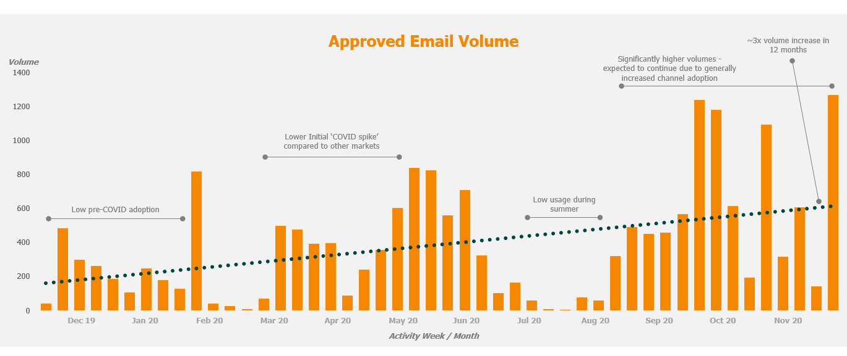
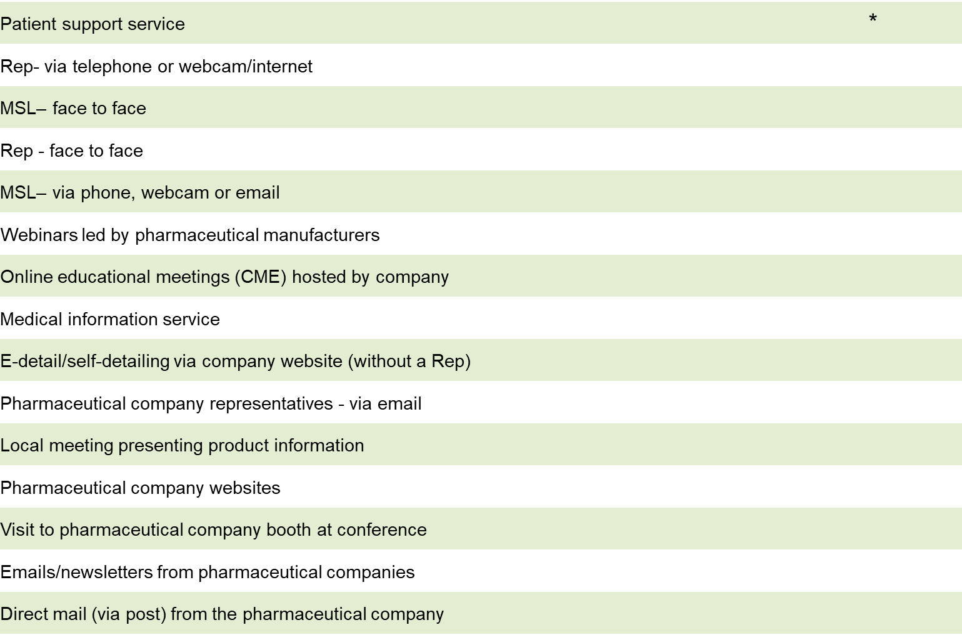
Channel Data Sources
We have lots of existing sources of data to understand the channel preferences of our target HCPs
ATU
Insights
Pulse

Slide 28


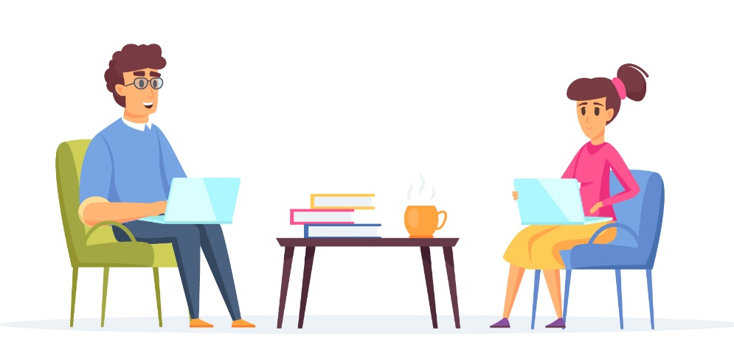
Touchpoints Options Per Scenario
Field-Driven
HCP-Driven
Event-Driven
E-Detail (F2F)
Galapagos Health
All Channels
Engage Call
3rd Party Websites
Approved Email
Peer Webinars
Physical Mail
Digital Media
Leave-Behinds
Mass Email
Links to External Resources (Websites etc.)
3rd Party Publications
More?
Podcasts

Slide 29



Generating Behavioural Preferences
The reality is that market research can never give us 100% accuracy, we must learn the channel preferences ourselves – gathering insight by action
Step 1 - Engage
Step 2 - Learn
Step 3 - Improve
Launch Campaigns & interact with Physicians
Measure Open Rates, F2F/Remote call ratios, gather qualitative rep input.
Update ‘real’ channel preferences to the HCP profile

